Slide 1
Fundamentals of Machine Learning Week 6: Text mining
Jonas Moons
All images are either own work, public domain, CC-licensed or fair use
Credits on last slide

Slide 2
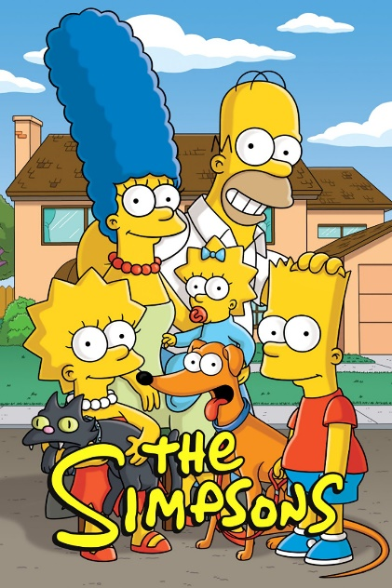
Intro

Slide 3
Topics
Natural Language Processing (NLP)
Modeling text in English and similar languages
Classification with Naïve Bayes

Slide 4
Natural language processing
Production
Natural language generation
Text-to-speech
Chatbots
Recognition
Speech recognition
Understanding written text
Translation

Slide 5
Challenges
Requires huge corpora and tagged databases
Specialized algorithms and linguistic expertise
Context is everything
Diversity of languages

Slide 6

Language is complex…
“What are you doing in this classroom?”
Morphology (how words are formed)
→ ‘do-ing’, ‘are’
Syntax (sentence construction, word order)
→ what are you …
Semantics (what words mean)
→ 'classroom': room in a school
Pragmatics (meaning in context)
→ ‘get out!’

Slide 7
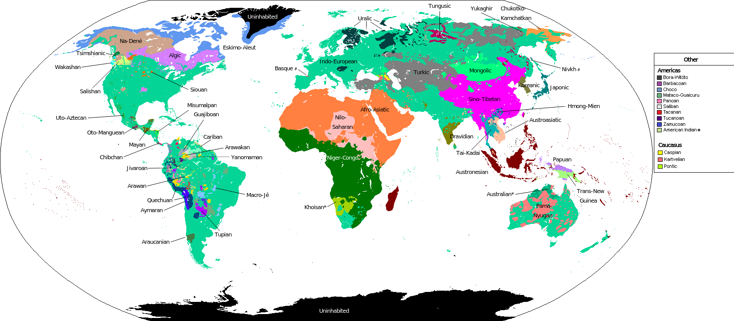
Languages of the world

Slide 8
Diversity challenges for NLP
Most work done on English
Also some on Mandarin Chinese, Arabic, French, others
Availability of corpora, text mining libraries, tagging algorithms…
Different scripts
Characteristics of English that many languages don't share
Easy phone-based writing system
Clear what is a word from text (spaces)
Simple morphology (word form)
Bender rule: state which language you're working in

Slide 9
Topics
Natural Language Processing (NLP)
Modeling text in English and similar languages
Classification with Naïve Bayes

Slide 10

Bag of words
The ‘bag of words’ model treats a document as a collection of words, and a count for each
It ignores semantics, syntax (word order), morphology and pragmatics (e.g., irony)
Very simple but often effective for many languages
Word | Count
You | 8
I | 6
And | 5
Will | 5
Be | 4

Slide 11
Tokenizing
Tokenizing is about breaking text up into units (‘words’)
Relatively easy in English…
(But what about ‘New York’, ‘ice cream’)
A lot harder in ‘agglutinative’ languages like Turkish or Finnish

Slide 12
Document-feature matrix
Features / words / variables
 | flouncy | flow | flower | flowery | flowey | flowier
Doc1 | 0 | 0 | 0 | 1 | 0 | 0
Doc2 | 0 | 0 | 0 | 0 | 0 | 0
Doc3 | 0 | 0 | 2 | 0 | 0 | 0
Doc4 | 0 | 0 | 0 | 0 | 0 | 0
Doc5 | 0 | 1 | 0 | 0 | 0 | 0
High-dimensional & sparse: almost entirely empty

Slide 13
Exercise 1: building a text model
During this week, you are going to work with dialog lines from the Simpsons. Your task during this week is to build a model that distinguishes Bart’s dialogue from Lisa’s dialogue.
For this exercise, you can use the text_mining Example Notebook
Load in the .csv file and have a look at the data set. What will be challenging when building a predictive model?
We will only work with Bart’s and Lisa’s lines. Make the relevant selection in the data set. Tip: this is a selection based on two conditions. Use brackets () around each condition and use | instead of or in Pandas. If you are stuck, ask!
Create a document-feature matrix of the text data.
Print a selection of the features/words.
The next step should not freeze your computer, but just in case: save your files. Try and make a regular matrix out of the sparse matrix and add it to the data frame. How much memory does Python use now? (Windows: Task manager / Taakbeheer. Apple: Activity Monitor)

Slide 14
Lemmatization and stemming
Lemmatization: means reducing a word to its grammatical stem
Removing pre- and suffixes for things like gender, number, tense, aspect, etc.
Going, goes, gone, go → go
Falo, falas, fala, falamos, falam, falava, falavas, falávamos, falavam, falei, falaste, falou, falámos, falaram, falarei, falarás, falará, falaremos, falarão, falaria, falarias, falaria, falaríamos, falariam,… → falar
Not included in sklearn. Some text mining libraries include nltk and others

Slide 15
Topics
Natural Language Processing (NLP)
Modeling text in English and similar languages
Classification with Naïve Bayes

Slide 16
Bayes’ theorem
P(“offer” & spam) = 30% x 50% = 15%
15 spam mails contain "offer" (50%)
If we encounter the word “offer”, the e-mail is about twice as likely (15/7) to be spam than not
30 spam mails (30%)
70 normal mails (70%)
The majority of e-mail is not spam
7 normal mails contain "offer" (10%)
P(“offer” & mail) =
70% x 10% = 7%

Slide 17
Bayes’ theorem in text mining
We can use Bayes’ theorem to calculate a probability that a text belongs to a certain category (e.g., spam)
The frequency of each word determines the probability
But how do we combine the probabilities of the different words?

Slide 18
Naïve Bayes
If I flip two coins, the probability of one coin being heads does not influence the other: they are independent. We can multiply the probabilities.
The probabilities of two words being in a text (e.g., ‘police’ and ‘crime’) are definitely not independent
Yet this is exactly what is assumed in Naïve Bayes (hence: ‘naïve’), and it works well in practice

Slide 19
Exercise 2: Naïve Bayes
For this exercise, we will not use example code. Instead, you will write the code yourself based on the kind of code that you wrote before. See the Cookbook for reference.
See the documentation of sklearn.naive_bayes_MultinomialNB for the Naive Bayes model object.
Steps:
Import the relevant libraries and/or objects
Create X and y variables – y is the colummn with the character names, X is the document-feature matrix
Split the data into a training and a test set
Fit a NB model on the training set
Predict the classes (Lisa or Bart) of the test set and store the result in a variable
Calculate the accuracy of your model (there is a method in MultinomialNB for this)

Slide 20
Classification
Under the hood (like Random Forest) the output of the Naive Bayes algorithm is not actually a class
Instead, it gives probabilities for each class C_{i}:
P(Y = C_{i} | X): the probability of class C
The classification is based on the class with the highest probability

Slide 21
Evaluation of classification
 | Predicted: Not spam | Predicted: Spam | Total
Actual: Not spam | 20 | 10 | 30
Actual: Spam | 40 | 60 | 100
Total | 60 | 70 | 130
Confusion matrix:
What proportion is correctly
predicted?
$$accuracy=\frac{correctly pred.}{total cases}= \frac{20+60}{20+40+10+60}=\frac{80}{130}=0.62$$
How much of the predicted ‘spam’ is actually spam?
$$precision (spam)=\frac{correctly pred. (spam)}{total pred. (spam)}=\frac{60}{60+10}=\frac{60}{70}= 0.86$$
How much of the real spam is predicted as spam?
$$recall (spam)=\frac{correctly pred. (spam)}{total actual (spam)}=\frac{60}{40+60}=\frac{60}{100}=0.60$$

Slide 22
Exercise 3: evaluation
In this exercise we will evaluate the model and delve further into the data. Remember that you can use the Cookbook for examples of code.
Start where you left off. Create a confusion matrix.
Calculate the accuracy and the recall and precision for both Bart and Lisa.
Check out the documentation on how to get the probabilities for a certain text belonging to a class (tip: it’s a method), instead of a categorization. Try it on a line of dialogue.
Create a loop that prints out a few lines of dialogue and the associated probabilities for Bart and Lisa. Tip: the array with the probabilities is 2-dimensional.
Check out the output. Do you see patterns (based on the data and your knowledge of the Simpsons)?

Slide 23
Image credit
Simpons by 20th century Fox, fair use claimed
Sloth meme by author unknown, fair use claimed
Bag by wixin_56: public domain
Languages of the world by Alumnum: CC-ASA 4.0

